Slide 1


Solar EURACBot: The Harmonic Blend of AI Brilliance and Solar System Health. A Seamless Integration of Digital Insight and Photovoltaic Care.
Mousa Sondoqah
31.08.2023

Slide 2
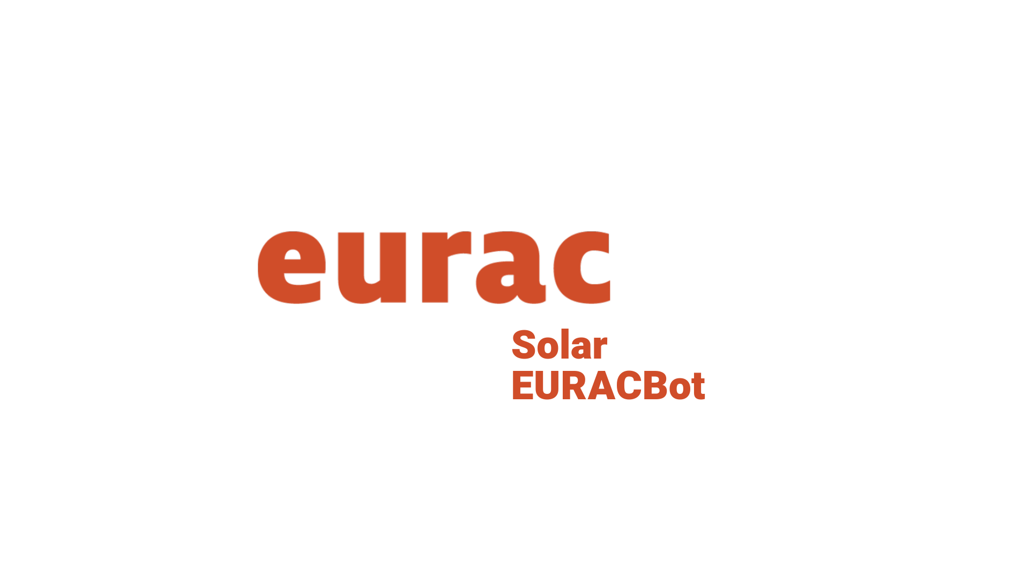

Transitioning from Web Dashboards to Telegram's Conversational Interfaces
Telegram's Reach: Leverage the widespread use and accessibility of Telegram for monitoring and operations.
Instant, Anywhere Access: With Telegram, receive real-time feedback from AI agents on-the-go.
Simplicity Over Complexity: Replace intricate web dashboards with Telegram's intuitive chat interface.
Personalized Telegram Experience: AI agents on Telegram adapt to user preferences, offering tailored advice and insights.
Cost-Effective Transition: Reduce overheads by utilizing Telegram's platform, eliminating the need for complex web apps.

Slide 3
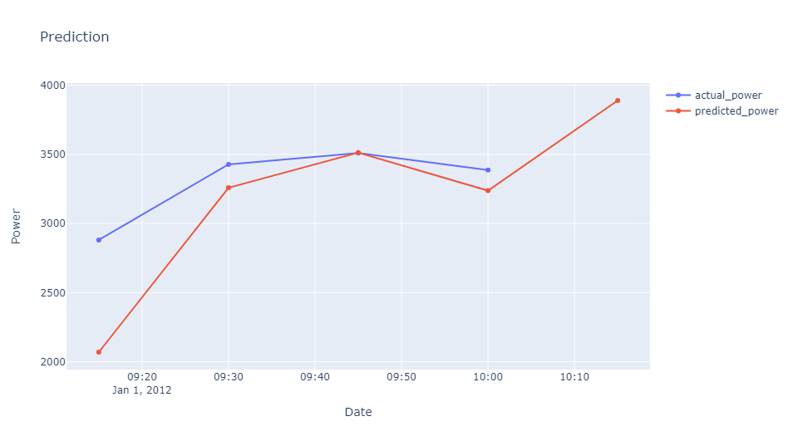
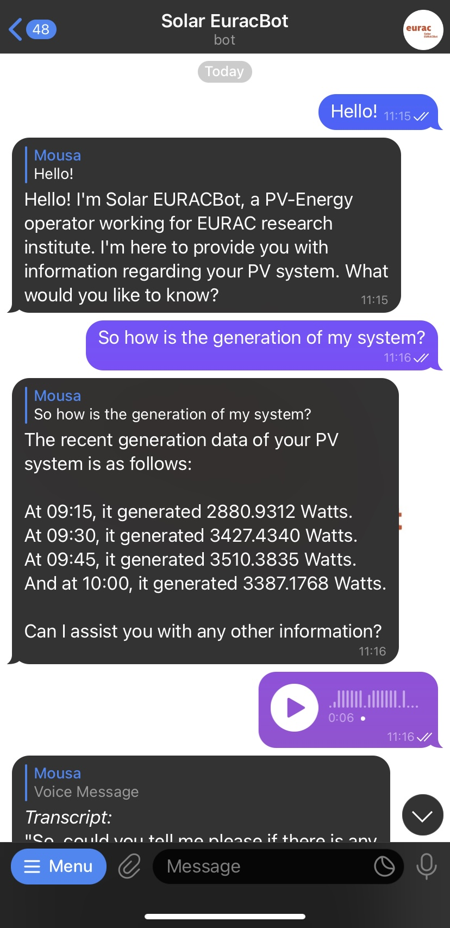
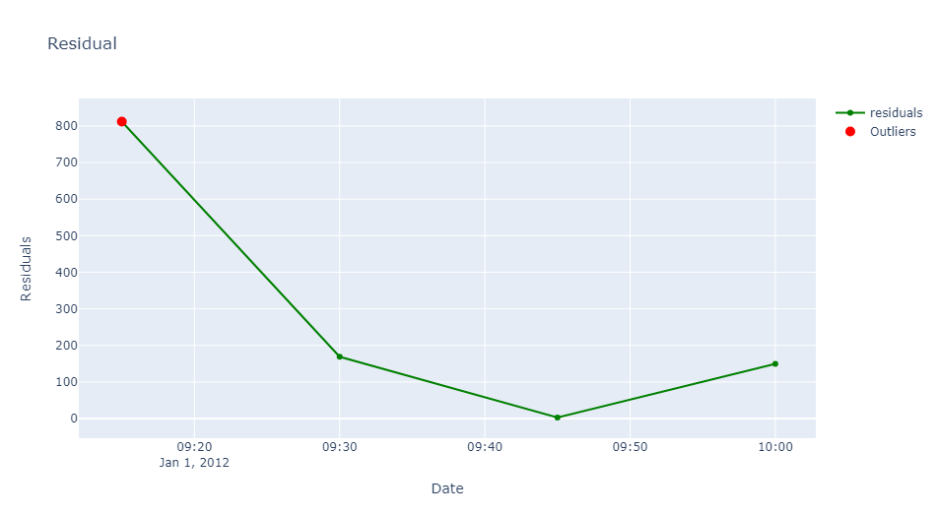
From Web Dashboards to Conversational Interfaces

Slide 4
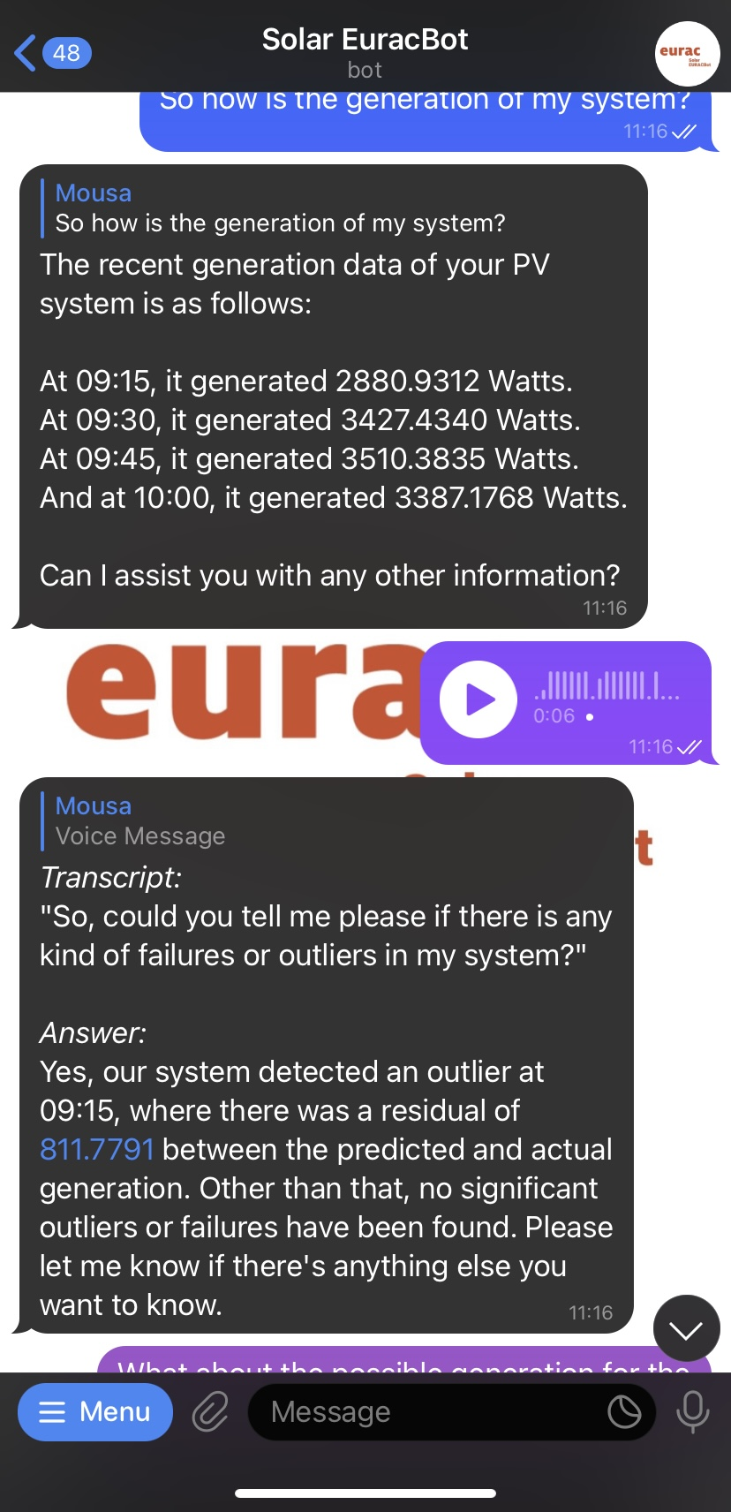
Voice-Activated Conversations with Solar EURACBot on Telegram
Seamless Vocal Interactions: Engage with Solar EURACBot using natural voice commands. Whether you're on the move or multitasking, just speak your query and receive auditory feedback, making system monitoring and operations more intuitive and hands-free.

Slide 5
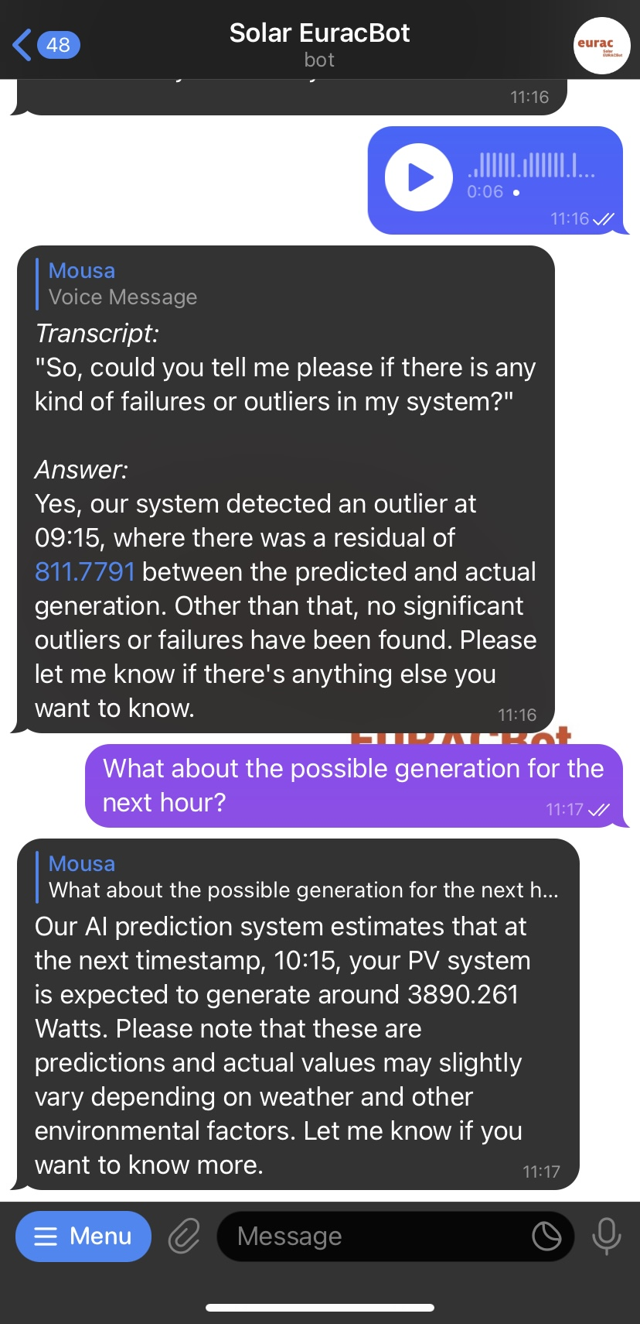
Voice-Activated Conversations with Solar EURACBot on Telegram
Solar EURACBot goes beyond simple conversations. Integrated with a robust deep learning pipeline, it offers enhanced capabilities for accurate predictions and timely anomaly detection in PV systems. This fusion of conversational AI and advanced analytics ensures that users receive both interactive and insightful feedback on their solar operations.

